Slide 1
New Golden Age of Film
1934-1944

Slide 2
Classical Film Score of the 1930s
Extensive use of music
Full range of orchestral colors
Relied on melody-dominant post-romantic style
Principal themes and moods were established during the opening credits
Musical support for moods, settings, characters and action
Frequent borrowing of familiar melodies
Unity through leitmotifs and thematic transformation

Slide 3
Important Films
1935
Mutiny on the Bounty, Herbert Stothart
The Informer, Max Steiner
Bride of Frankenstein, Franz Waxman
1937
Snow White and the Seven Dwarfs
1938
The Adventures of Robin Hood, Erich Korngold

Slide 4
Animated Features
Snow White and the Seven Dwarfs was the first full-length animated film (1937)
Earned more money than any film in the 1930s except for Gone with the Wind
Music plays throughout
Distinction between developed songs sung by humans and simple tunes for the dwarfs
Disney animated films were the top three grossing films in the 1940s (Pinnochio, Dumbo, Bambi)
Disney stopped making feature films during WWII to make cartoons that supported the war effort

Slide 5
1939: Hollywood’s Greatest Year
Significant Films:
Mr. Smith Goes to Washington
Stagecoach
Wuthering Heights
The Wizard of Oz
Gone With the Wind

Slide 6
Adapted Scores: large portion of borrowed content
Mr. Smith Goes to Washington
Score by Dmitri Tiomkin
Very little underscoring because:
Type of comedy→ little underscoring
Populist film about the common man→ simple music
Little music due to the film taking place in the U.S. Senate
People felt is was inappropriate to have music playing for scenes in government buildings
The music that is used is adapted from American patriotic melodies

Slide 7
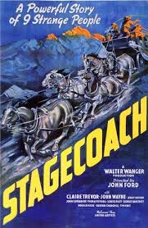
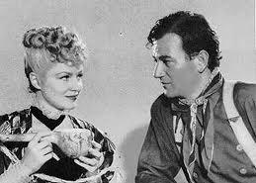
Stagecoach
Adapted Score by Richard Hageman
Stagecoach is the first great Western
Score based on cowboy and folk tunes
Hageman placed a lyrical tune over a fast-paced accompaniment
Became a cliché in Westerns
Effectively uses music to show contrast between the stagecoach and Indians

Slide 8
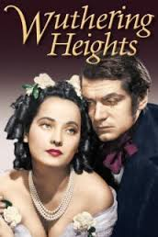
Original Scores in 1939
Wuthering Heights
Score by Alfred Newman
Heathcliff, a poor boy of unknown origins is rescued from poverty and taken in by a family where he develops an intense relationship with his foster sister, Cathy.
Story and the weather focuses on the characters’ conflict, the music focuses on their love
Music written mostly for strings
Cathy’s love theme dominates the film and even plays through when she dies
waltz

Slide 9
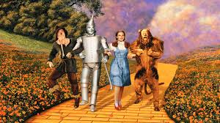
Wizard of Oz
Greatest film musical of
the 1930s
Harold Arlen: wrote the songs
Herbert Stothart: adapted the songs and wrote the underscoring
Over the Rainbow is the most fully developed song
other songs are catchy tunes: Ding Dong, Yellow Brick, We’re Off to See the Wizard
Full song in Kansas, short songs in Oz
Also borrows from classical pieces

Slide 10
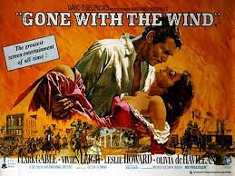
Gone With the Wind
Score by Max Steiner (one of 12 he did that year)
Wrote 3 hrs 45 min of music in 4 weeks
Was also working on another score and supervising the recording of both works
Quoted familiar music (Dixie, Taps, etc)
Used long melodies for themes

