Slide 1
Neo-Classical Era-2

Slide 2
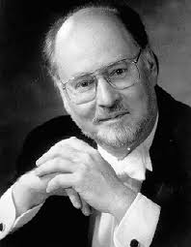
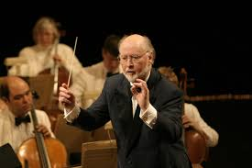
John Williams
Most well-known film composer
Served in the Air Force, attended Julliard
Worked as a pianist for film and tv studios to get his start
Early film scores were for comedies

Slide 3
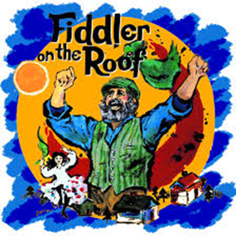
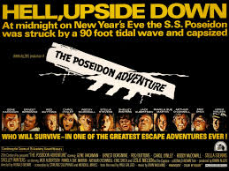
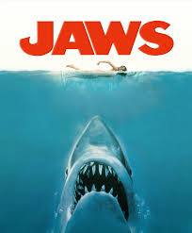
John Williams
First Oscar in 1971: Orchestrating & Adapting Fiddler on the Roof
1972: The Poseidon Adventure→earned him a reputation for disaster films
- Led to Jaws & working with
Stephen Spielberg

Slide 4
John Williams
Has 5 Best Music Oscars (nominated for 48)
Serves as principal conductor for the Boston Pops Orchestra
Can use both classical and jazz styles
Known for borrowing from other composers and from himself
  Interview w/ John Williams

Slide 5
1967: Valley of the Dolls
1971: Fiddler on the Roof
1972: The Poseidon Adventure
1975: Jaws
1977: Close Encounters of a Third Kind
1977: Star Wars
1978: Superman: The Movie
1980: The Empire Strikes Back
1981: Raiders of the Lost Ark
1982: E.T.: the Extra-Terrestrial
1983: Return of the Jedi
1990: Home Alone
1991: JFK
1991: Hook
1993: Schindler’s List
1993: Jurassic Park
1998: Saving Private Ryan
1999: The Phantom Menace
2001: Harry Potter
2001: Artificial Intelligence: A.I.
2002: Attack of the Clones
2002: Catch Me if You Can
2004: Prisoner of Azkaban
2005: Memoirs of a Geisha
2005: War of the Worlds
2011: War Horse
2011: Lincoln
2013: The Book Thief

Slide 6
E.T. the Extra Terrestrial
Opening
2. Getting Drunk
3.Saving the Frogs
4. E.T. Phone Home
5
6.
7.
8.
9.
10.

Slide 7
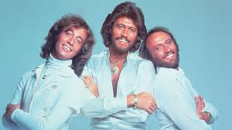
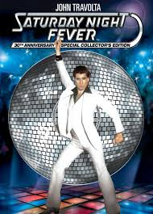
Non-Symphonic Scores:
Post-Star Wars
Popular Music Scores
  Used disco as the preferred form of pop music
  Saturday Night Fever(1977)
    Soundtrack by Bee Gees sold over 30 million copies
    Film brought Disco into the mainstream
    Story about a dancer provided many spots for music

Slide 8
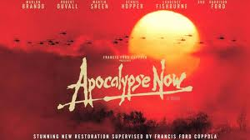
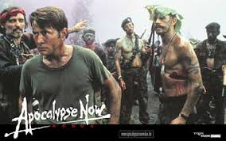
Eclectic Scores
Apocalypse Now (1979)
  Deals with why we lost the Vietnam War
  Uses a wide range of music to show different view points
    The End by The Doors used in the intro
      Why:
    Satisfaction by the Rolling Stones
      Why:
    Ride of the Valkyries by Wagner
      Why:

Slide 9
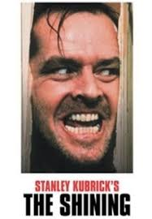
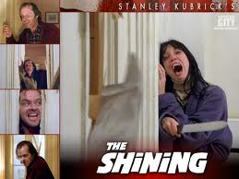
Adapted Scores
The Shining(1980)
  Uses classical music from the 20th century
  Music is edited to support the drama (cuts, deletions, extensions)
  Film was also edited to fit the music

Slide 10
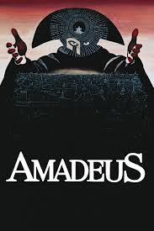
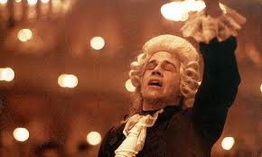
Amadeus (1984)
  One of the most highly regarded films of the ’80s
  Follows Mozart’s life through the eyes of the jealous Salieri
  All music in the film is Mozart’s: used as source music and underscoring

Slide 11
Neoclassical scores
Jaws
Star Wars
John Willams’ significance
John Williams’ style
Star Wars’ themes
E.T.
Adapted Scores
Eclectic Scores
Synthesized Scores
Popular Music Scores
Americana
Exotic Locations

