Slide 1
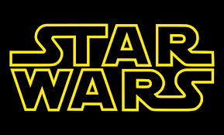
Star Wars

Slide 2
The Importance of Star Wars
Beginning of Neoclassical phase
  Neoclassicism: return to the “golden era”
Return to romanticism (wanted to get an emotional response from the audience)

Slide 3
Just like a classical film score
Use of symphony orchestra
Wall-to-wall underscoring
Music supports the mood
Post-romantic style of music
Unity through leitmotifs

Slide 4
John Williams’ Style
Traditional style (timeless)
Popular music only used for source music
Borrowed from Copland’s “American” style
Quotes and imitates other classical pieces

Slide 5
Leitmotifs(Themes for a character/place/idea))
Most films have 1 leitmotif (Jaws)
The Star Wars movies have many that are used throughout the original trilogy and the newer prequels

Slide 6
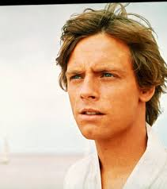
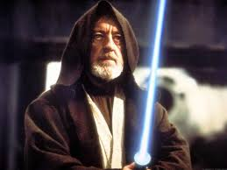
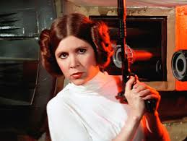
Leitmotifs in Star Wars: Episode IV
Luke Skywalker
Obi-Wan Kenobi/The Force
Princess Leia

Slide 7
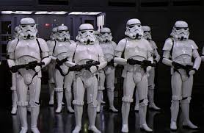
Leitmotifs in Star Wars: Episode IV
Imperial March

Slide 8
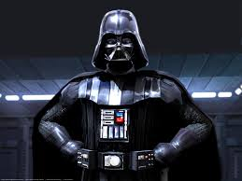
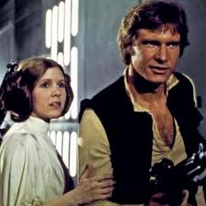
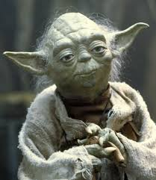
New Leitmotifs for Empire Strikes Back
Darth Vader
Han Solo & Princess Leia
Yoda

Slide 9
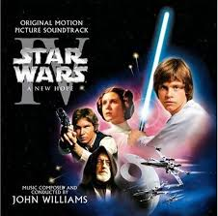
Star Wars: Episode IV - A New Hope
The story concerns a farm boy named Luke Skywalker who discovers that the used robot recently purchased by his family plays back a message from one Princess Leia begging for help from Obi-Wan Kenobi. Luke asks his father's friend Ben Kenobi about this, and he discovers that Ben and Obi-Wan are one and the same. Kenobi tells Luke of the battle of the rebels against the ruling Empire and the spiritual energy called "The Force." Soon Luke, Kenobi, and a mercenary named Han Solo join forces to rescue Princess Leia from the Empire's mammoth warship, the Death Star, controlled by evil genius Darth Vader.

Slide 10
The Empire Strikes Back
Imperial forces have since driven the Rebels to hide on the ice world Hoth. But even on such an icy, backwater world, they cannot escape the evil Darth Vader's eyes for long, and he devastates the Rebel base in an assault with the Imperial AT-AT walkers. Luke flees to Dagobah to begin Jedi training with Master Yoda, while Han Solo, Chewbacca, Princess Leia and C-3PO run the blockade of Imperial Star Destroyers in the Millennium Falcon. The Imperials pursue them across the galaxy and eventually catch up with them on Bespin. Now Darth Vader plans to use them as bait to lure Luke Skywalker to him, and turns Han Solo over to Boba Fett as a prize to be delivered to crime lord Jabba the Hutt. Darth Vader tells Luke that he is his father, and tries to convince him to join him on the Dark side. Luke falls off the ship and is rescued by Leia. The movie ends with Luke getting fitted for an artificial hand while Lando and Chewbacca set out in the Falcon to locate Han Solo.

Slide 11
The Return of the Jedi
Darth Vader and the Empire are building a new, indestructible Death Star. Meanwhile, Han Solo has been imprisoned, and Luke Skywalker has sent R2-D2 and C-3PO to try and free him. Princess Leia - disguised as a bounty hunter - and Chewbacca go along as well. The final battle takes place on the moon of Endor, with its natural inhabitants, the Ewoks, lending a hand to the Rebels. Darth Vader is killed by the Emporer, the Death Star is destroyed and everyone celebrates on Endor.

